Slide 1
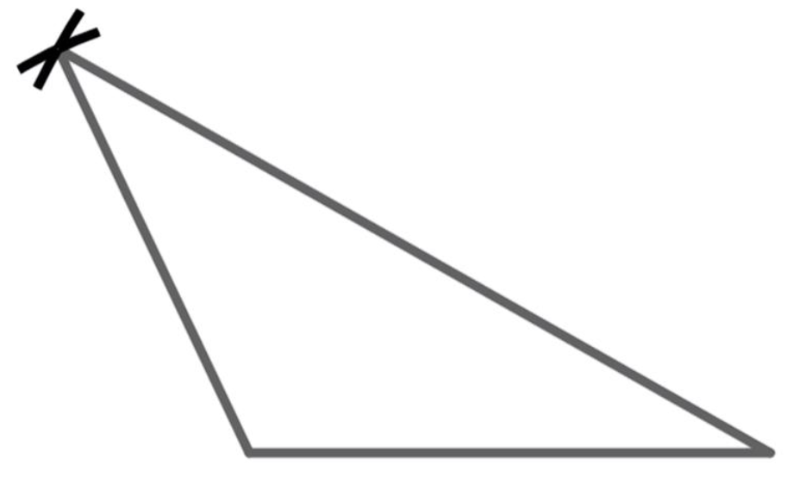
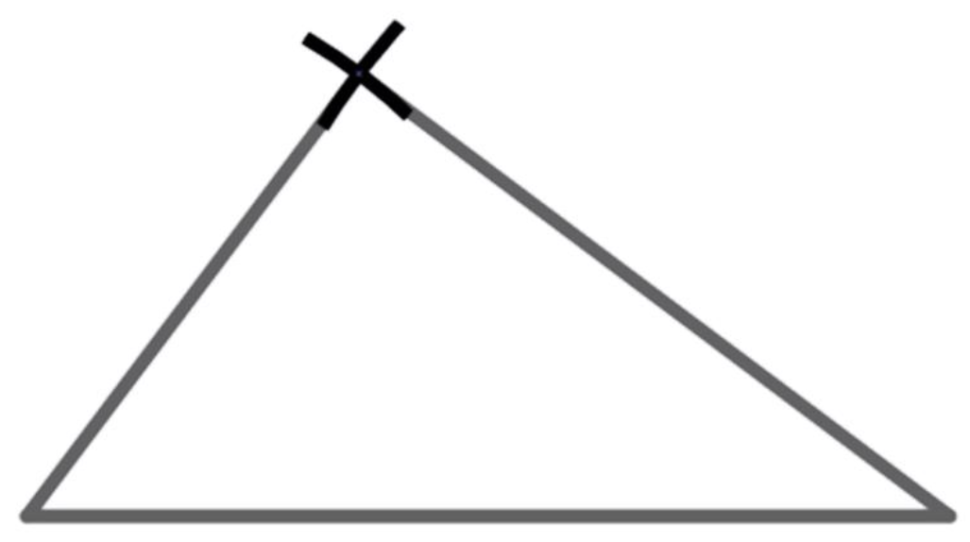
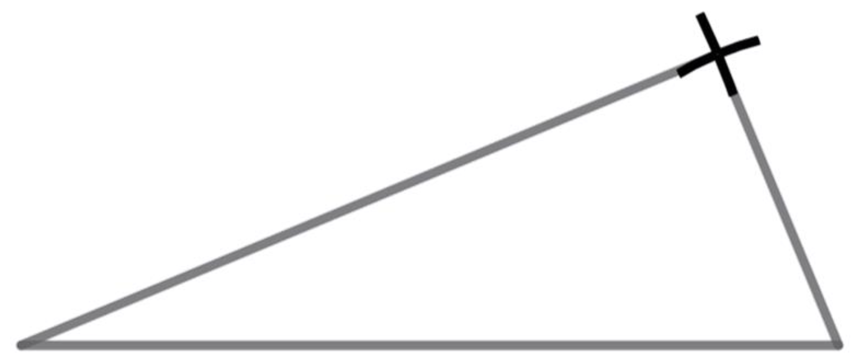
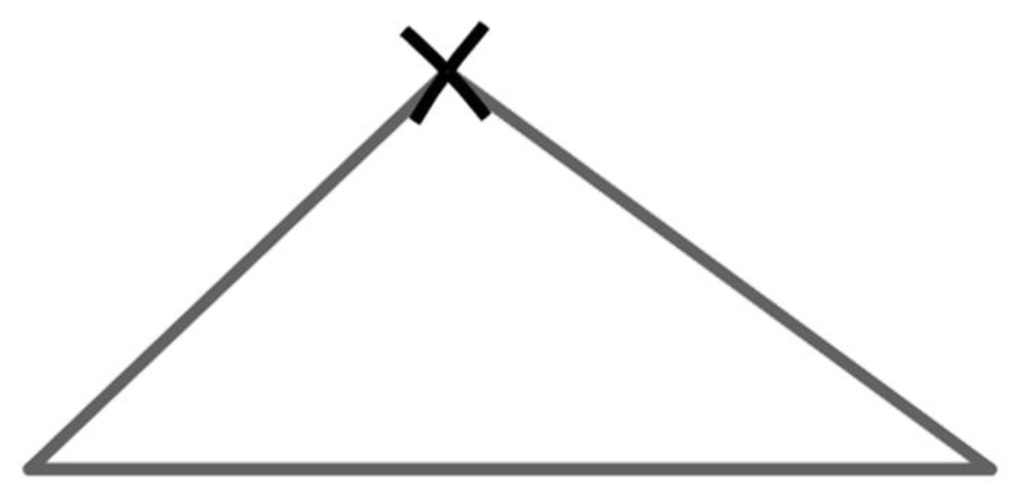
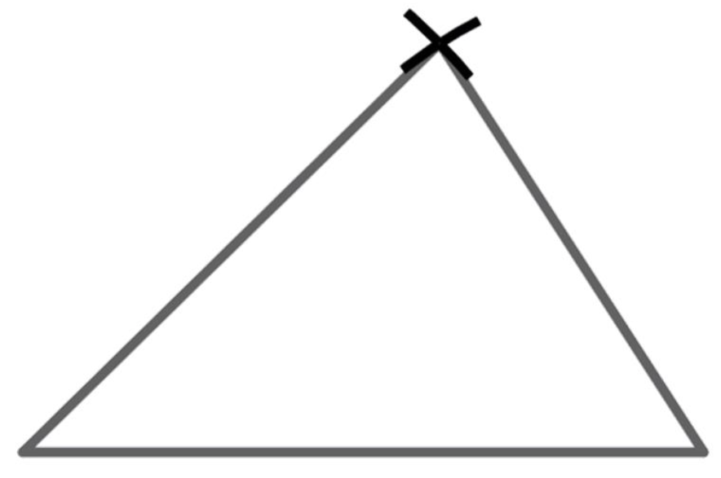
Constructing triangles
Task A: Constructing a scalene triangle
Not drawn to scale.
To check your accuracy, measure the marked angles with a protractor.
1) Construct this triangle accurately.
11 cm
6 cm
11 cm
6 cm
115°
30°
7 cm
7 cm
2) Construct the triangle with edge lengths 6 cm, 8 cm and 10 cm.
Not drawn to scale.
The angle between the 6 cm edge and the 8 cm edge should be 90°. Use a protractor to check it.
6 cm
8 cm
10 cm
3) Construct triangle ABC, where AB = 12 cm, BC = 13 cm and AC = 50 mm.
Not drawn to scale.
The angle between AB and AC should be 90°. Use a protractor to check it.
A
12 cm
5 cm
B
13 cm
C
4) Construct the scalene triangle that has an edge of 6 cm, an edge of 7 cm and a perimeter of 23 cm.
Not drawn to scale.
If the perimeter is 23 cm and two of the edges sum to 13 cm, then the third edge will need to have a length of 10 cm. To check your accuracy, measure the marked angles with a protractor.
6 cm
7 cm
44°
36°
10 cm
5) Construct a scalene triangle with a perimeter of 180 mm.
An example of a correct answer (Not drawn to scale):
60 mm
50 mm
70 mm

Slide 2
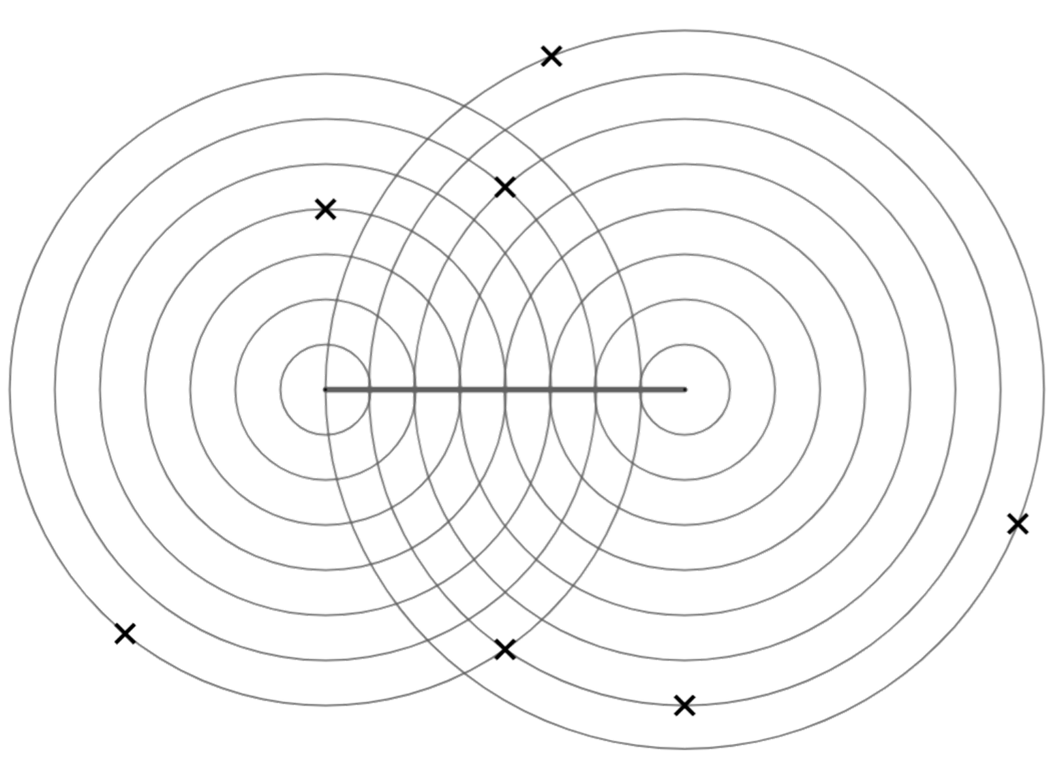
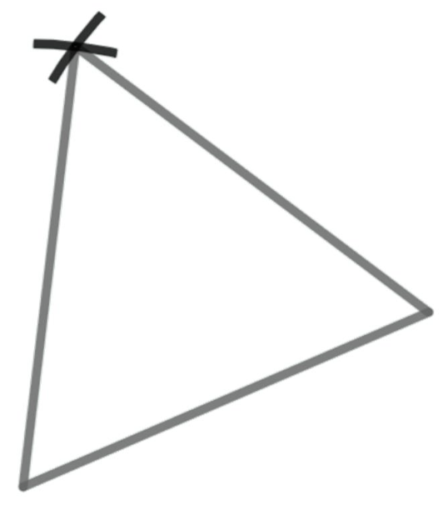
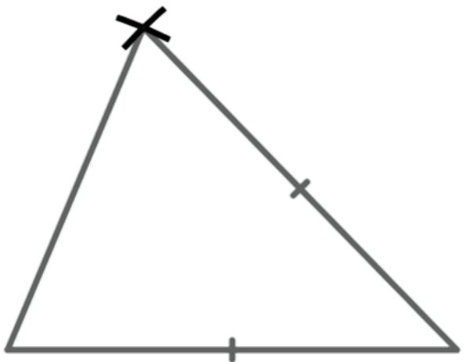

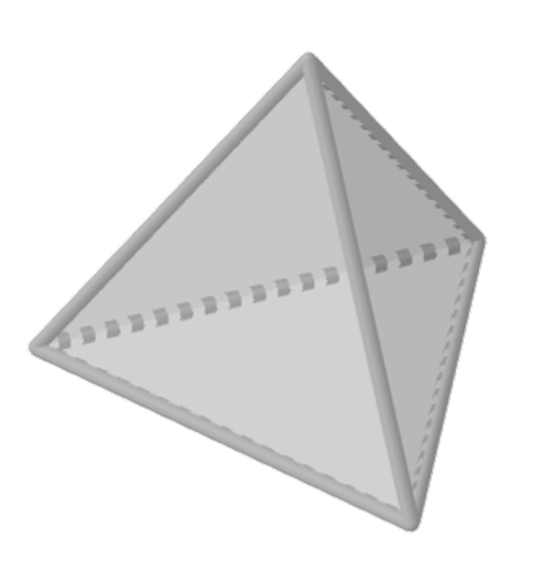
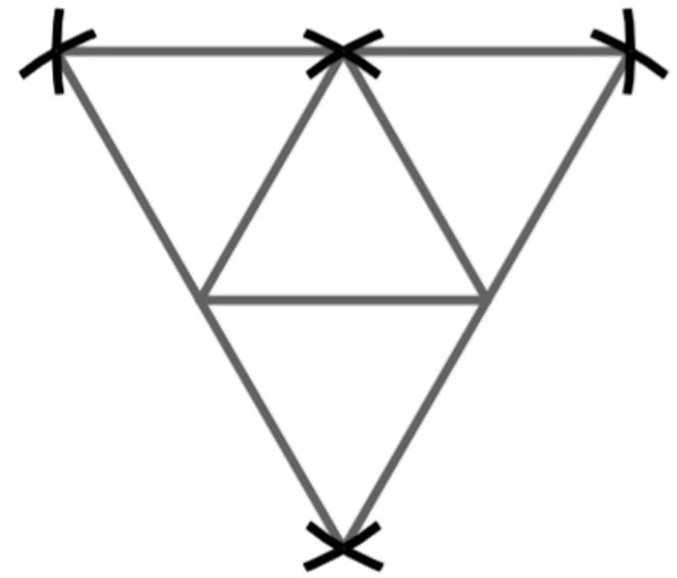
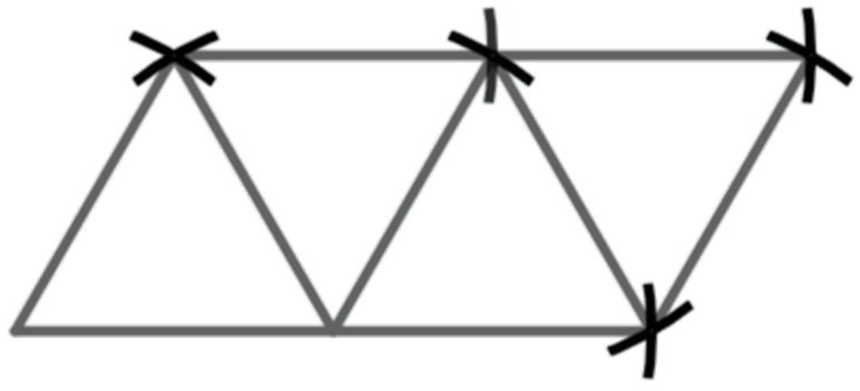
Constructing triangles
Task B: Constructing triangles with equal edges
1) XY is an edge of a triangle. Which of the points A to G when joined to XY would create:
C
a) an isosceles triangle
A
B
B, C, D, F
b) a right-angled triangle
X
Y
A and E
D
c) a right-angled isosceles triangle
G
F
There isn’t one.
E
2) Construct an equilateral triangle, using the line as one of the edges.
Check your angles with a protractor; they should all be 60°
3) Construct an isosceles triangle where the equal edges are 9 units and the base edge is 7 units. Use this scale.
Check your angles with a protractor.
67°
46°
4) A tetrahedron is a 3D shape with four equilateral triangular faces. Construct the net of a tetrahedron. Draw this on a separate sheet of paper.
Two distinct nets of a tetrahedron
Mathematics in Education and Industry.
v2.3

